Slide 1

Network Layer

Slide 2
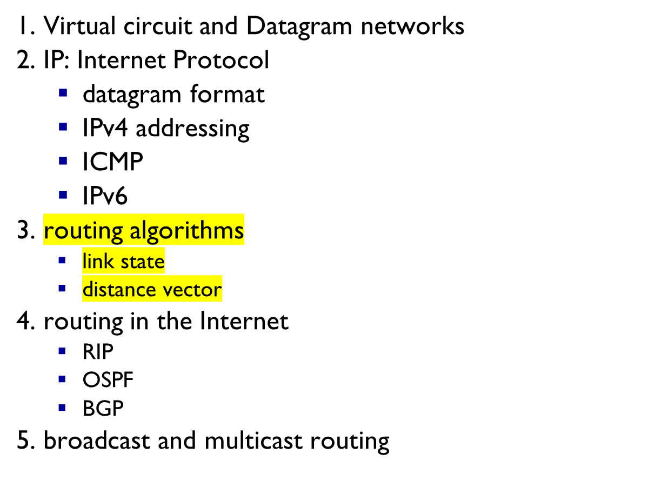
Outline
Network Layer
4-<number>

Slide 3
















Network layer
transport segment from sending to receiving host
on sending side encapsulates segments into datagrams
on receiving side, delivers segments to transport layer
network layer protocols in every host, router
router examines header fields in all IP datagrams passing through it
application
transport
network
data link
physical
network
data link
physical
network
data link
physical
network
data link
physical
network
data link
physical
network
data link
physical
network
data link
physical
network
data link
physical
network
data link
physical
network
data link
physical
application
transport
network
data link
physical
network
data link
physical
network
data link
physical
Network Layer
4-<number>

Slide 4
DELIVERY
The network layer supervises the handling of the packets by the underlying physical networks. We define this handling as the delivery of a packet.
Network Layer
4-<number>

Slide 5



Network Layer
4-<number>

Slide 6


forwarding: move packets from router’s input to appropriate router output
routing: determine route taken by packets from source to dest.
  routing algorithms
analogy:
routing: process of planning trip from source to dest
forwarding: process of getting through single interchange
Network Layer
4-<number>

Slide 7
Interplay between routing and forwarding
routing algorithm
routing algorithm determines
end-end-path through network
local forwarding table
forwarding table determines
local forwarding at this router
header value
output link
0100
0101
0111
1001
3
2
2
1
value in arriving
packet’s header
0111
1
3
2
Network Layer
4-<number>

Slide 8
Connection setup
3rd important function in some network architectures:
  ATM, frame relay, X.25
before datagrams flow, two end hosts and intervening routers establish virtual connection
  routers get involved
network vs transport layer connection service:
  network: between two hosts (may also involve intervening routers in case of VCs)
  transport: between two processes
Network Layer
4-<number>

Slide 9
Connection, connection-less service
datagram network provides network-layer connectionless service
virtual-circuit network provides network-layer connection service
analogous to TCP/UDP connecton-oriented / connectionless transport-layer services, but:
  service: host-to-host
  no choice: network provides one or the other
  implementation: in network core
Network Layer
4-<number>

Slide 10


“source-to-dest path behaves much like telephone circuit”
  performance-wise
  network actions along source-to-dest path
call setup, teardown for each call before data can flow
each packet carries VC identifier (not destination host address)
every router on source-dest path maintains “state” for each passing connection
link, router resources (bandwidth, buffers) may be allocated to VC (dedicated resources = predictable service)
Network Layer
4-<number>

Slide 11
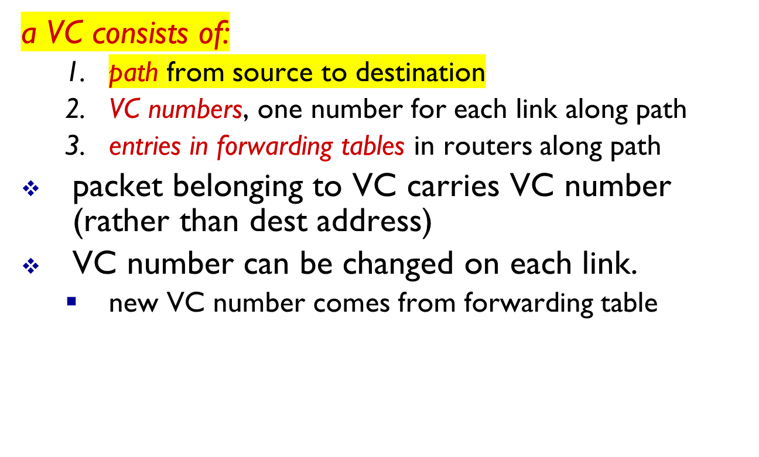
VC implementation
Network Layer
4-<number>

Slide 12

VC forwarding table
12
22
32
1
3
2
VC number
forwarding table in
northwest router:
interface
number
Incoming interface Incoming VC # Outgoing interface Outgoing VC #
1 12 3 22
2 63 1 18
3 7 2 17
1 97 3 87
… … … …
VC routers maintain connection state information!
Network Layer
4-<number>

Slide 13


used to setup, maintain teardown VC
used in ATM, frame-relay, X.25
not used in today’s Internet
application
transport
network
data link
physical
application
transport
network
data link
physical
5. data flow begins
6. receive data
4. call connected
3. accept call
1. initiate call
2. incoming call
Network Layer
4-<number>

Slide 14
Datagram networks
no call setup at network layer
routers: no state about end-to-end connections
  no network-level concept of “connection”
packets forwarded using destination host address
application
transport
network
data link
physical
application
transport
network
data link
physical
1. send datagrams
2. receive datagrams
Network Layer
4-<number>

Slide 15
Datagram forwarding table
4 billion IP addresses, so rather than list individual destination address
list range of addresses
(aggregate table entries)
routing algorithm
local forwarding table
dest address
output link
address-range 1
address-range 2
address-range 3
address-range 4
3
2
2
1
IP destination address in
arriving packet’s header
1
3
2
Network Layer
4-<number>

Slide 16
Datagram forwarding table
Destination Address Range
11001000 00010111 00010000 00000000
through
11001000 00010111 00010111 11111111
11001000 00010111 00011000 00000000
through
11001000 00010111 00011000 11111111
11001000 00010111 00011001 00000000
through
11001000 00010111 00011111 11111111
otherwise
Link Interface
0
1
2
3
Q: but what happens if ranges don’t divide up so nicely?
Network Layer
4-<number>

Slide 17
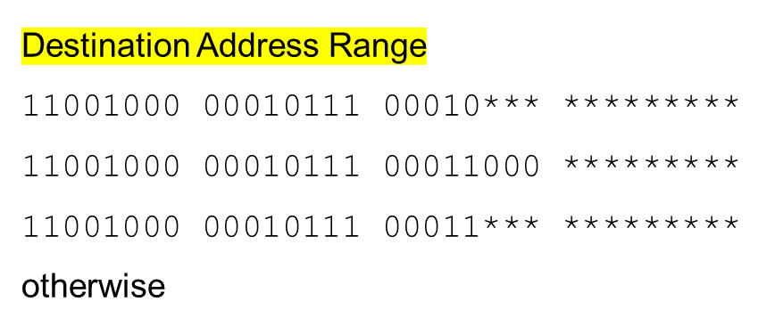

Longest prefix matching
longest prefix matching
when looking for forwarding table entry for given destination address, use longest address prefix that matches destination address.
Link interface
0
1
2
3
examples:
which interface? Ans: Interface 0.
which interface? Ans: Interface 1.
Network Layer
4-<number>

Slide 18
Datagram or VC network: why?
Internet (datagram)
data exchange among computers
  “elastic” service, no strict timing req.
many link types
  different characteristics
  uniform service difficult
“smart” end systems (computers)
  can adapt, perform control, error recovery
  simple inside network, complexity at “edge”
ATM (VC)
evolved from telephony
human conversation:
  strict timing, reliability requirements
  need for guaranteed service
“dumb” end systems
  telephones
  complexity inside network
Network Layer
4-<number>

Slide 19
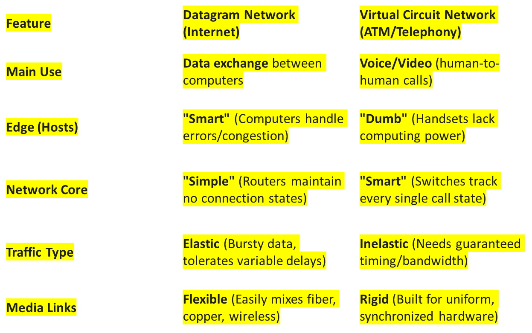
Datagram or VC network: why?
Here is a short comparison table summarized from the "Datagram or VC network: why?" slide:
Network Layer
4-<number>

Slide 20
Forwarding Methods
Network Layer
4-<number>

Slide 21
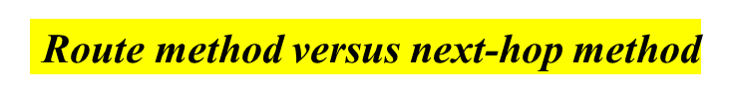








Slide 22








Slide 23

Default method

Slide 24

Simplified forwarding module in classless address

Slide 25
In classless addressing, we need at least four columns in a routing table.

Slide 26





Example 1
Make a routing table for router R1, using the configuration in Figure 1.
Solution
Table 22.1 shows the corresponding table.

Slide 27


Figure 1 Configuration
m3

Slide 28
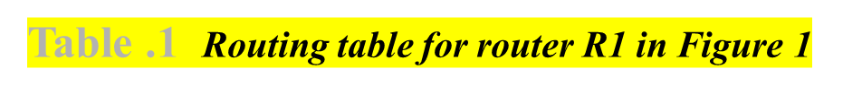

22.<number>

Slide 29





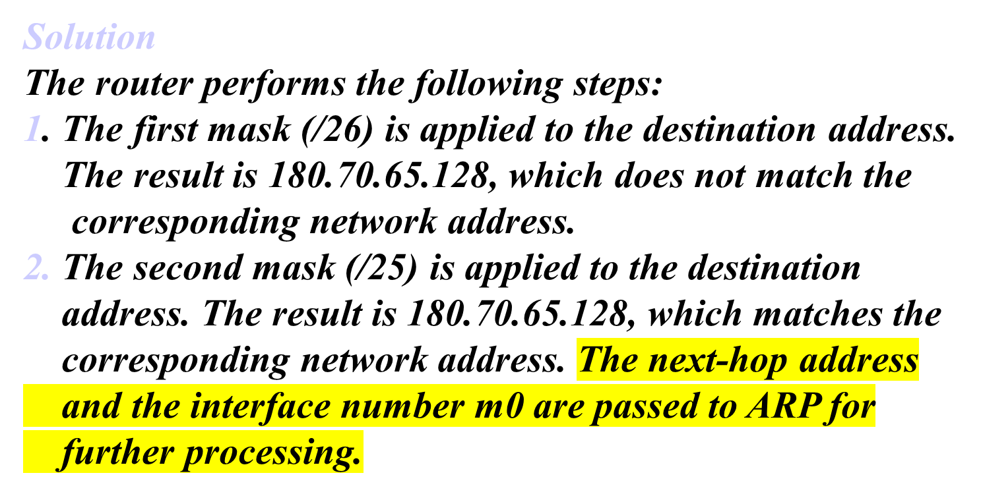
Example. 2
Show the forwarding process if a packet arrives at R1 in Figure 1 with the destination address 180.70.65.140.

Slide 30




Show the forwarding process if a packet arrives at R1 in Figure 1 with the destination address 201.4.22.35.
Solution
The router performs the following steps:
1. The first mask (/26) is applied to the destination
address. The result is 201.4.22.0, which does not
match the corresponding network address.
2. The second mask (/25) is applied to the destination address. The result is 201.4.22.0, which does not match the corresponding network address (row 2).
22.<number>

Slide 31
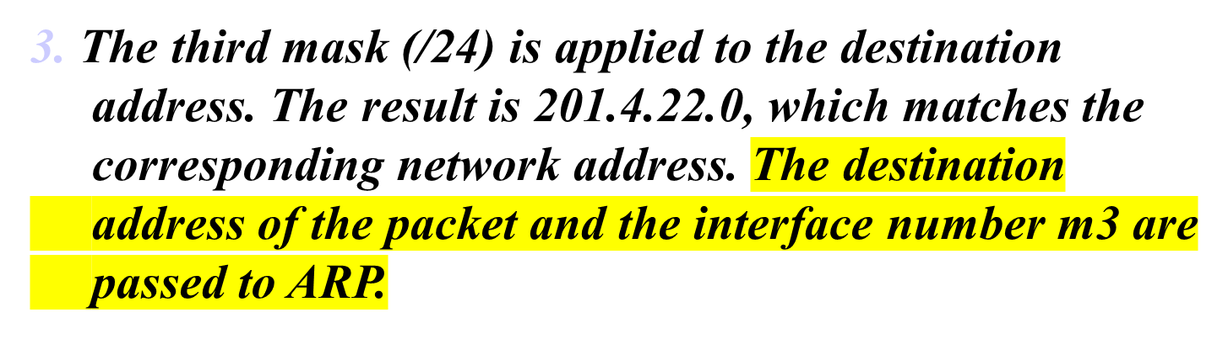
Example. 3 (continued)
22.<number>

Slide 32

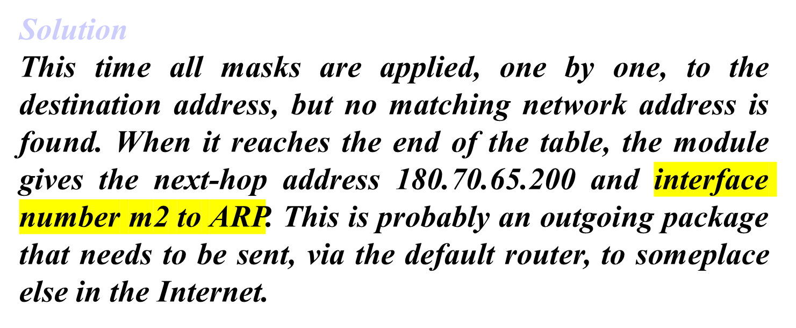
Show the forwarding process if a packet arrives at R1 in Figure 1 with the destination address 18.24.32.78.

Slide 33
_{Routing Table}
Static Routing Table.
Dynamic Routing Table

Slide 34
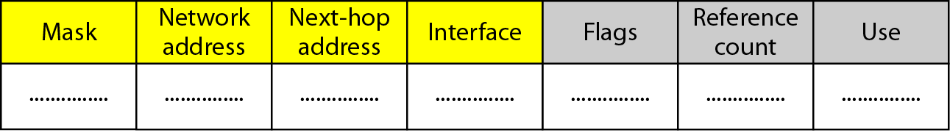
Figure 22.10 Common fields in a routing table
22.<number>

Slide 35





transport layer: TCP, UDP
routing protocols
path selection
RIP, OSPF, BGP
IP protocol
addressing conventions
datagram format
packet handling conventions
When a packet arrives on a router's input link, the router must move it to the appropriate output link. This is a local, per-router action that happens in a fraction of a millisecond.
network
layer
forwarding
table
ICMP protocol
error reporting
router “signaling”
link layer
physical layer
Network Layer
4-<number>

Slide 36
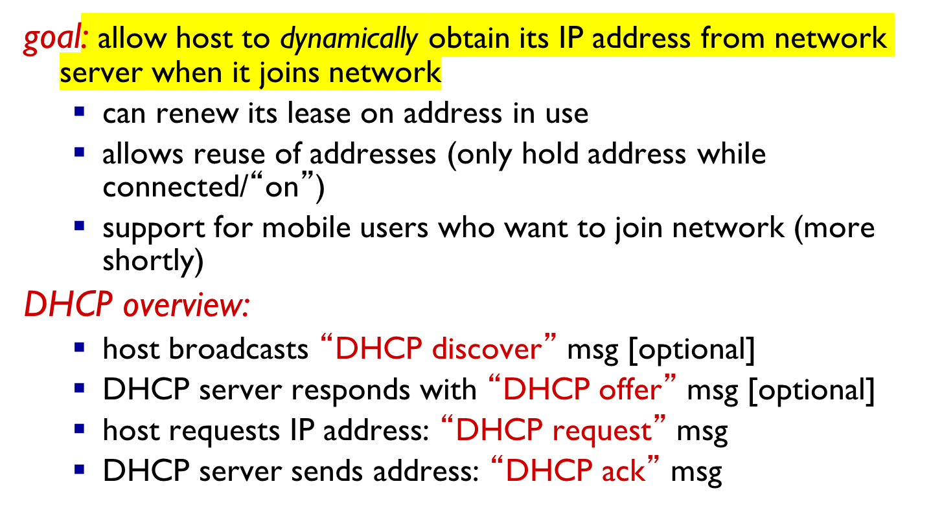
DHCP: Dynamic Host Configuration Protocol
Network Layer
4-<number>

Slide 37


DHCP client-server scenario
DHCP
server
223.1.1.0/24
223.1.1.1
223.1.2.1
223.1.1.2
arriving DHCP
client needs
address in this
network
223.1.1.4
223.1.2.9
223.1.3.27
223.1.2.2
223.1.1.3
223.1.2.0/24
223.1.3.1
223.1.3.2
223.1.3.0/24
Network Layer
4-<number>

Slide 38
DHCP client-server scenario
DHCP server: 223.1.2.5
DHCP discover
arriving
client
src : 0.0.0.0, 68
dest.: 255.255.255.255,67
yiaddr: 0.0.0.0
transaction ID: 654
Broadcast: is there a DHCP server out there?
DHCP offer
src: 223.1.2.5, 67
dest: 255.255.255.255, 68
yiaddrr: 223.1.2.4
transaction ID: 654
lifetime: 3600 secs
Broadcast: I’m a DHCP server! Here’s an IP address you can use
DHCP request
src: 0.0.0.0, 68
dest:: 255.255.255.255, 67
yiaddrr: 223.1.2.4
transaction ID: 655
lifetime: 3600 secs
Broadcast: OK. I’ll take that IP address!
DHCP ACK
src: 223.1.2.5, 67
dest: 255.255.255.255, 68
yiaddrr: 223.1.2.4
transaction ID: 655
lifetime: 3600 secs
Broadcast: OK. You’ve got that IP address!
Network Layer
4-<number>

Slide 39
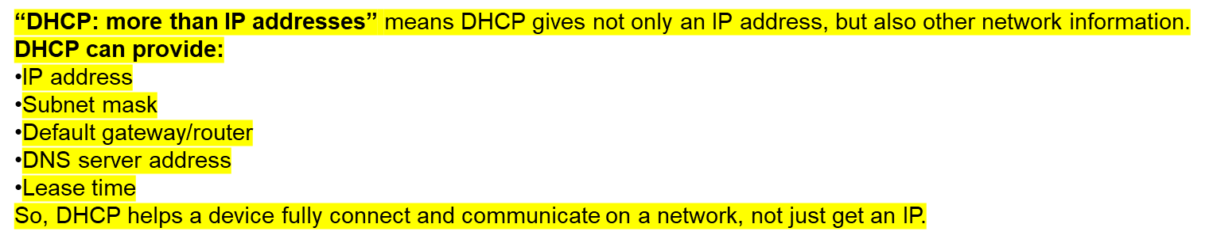
DHCP: more than IP addresses
DHCP can return more than just allocated IP address on subnet:
  address of first-hop router for client
  name and IP address of DNS sever
  network mask (indicating network versus host portion of address)
Network Layer
4-<number>

Slide 40


DHCP: example
DHCP
DHCP
UDP
IP
Eth
Phy
connecting laptop needs its IP address, addr of first-hop router, addr of DNS server: use DHCP
DHCP
DHCP
DHCP
DHCP
DHCP request encapsulated in UDP, encapsulated in IP, encapsulated in 802.1 Ethernet
DHCP
DHCP
UDP
IP
Eth
Phy
168.1.1.1
DHCP
DHCP
DHCP
Ethernet frame broadcast (dest: FFFFFFFFFFFF) on LAN, received at router running DHCP server
DHCP
router with DHCP
server built into
router
Ethernet demuxed to IP demuxed, UDP demuxed to DHCP
Network Layer
4-<number>

Slide 41
DHCP: example
DHCP
UDP
IP
Eth
Phy
DCP server formulates DHCP ACK containing client’s IP address, IP address of first-hop router for client, name & IP address of DNS server
DHCP
DHCP
DHCP
DHCP
encapsulation of DHCP server, frame forwarded to client, demuxing up to DHCP at client
DHCP
DHCP
UDP
IP
Eth
Phy
DHCP
DHCP
DHCP
router with DHCP
server built into
router
client now knows its IP address, name and IP address of DSN server, IP address of its first-hop router
DHCP
Network Layer
4-<number>

Slide 42


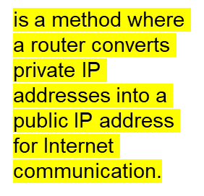
rest of
Internet
local network
(e.g., home network)
10.0.0/24
10.0.0.1
10.0.0.4
10.0.0.2
138.76.29.7
10.0.0.3
all datagrams leaving local
network have same single source NAT IP address: 138.76.29.7,different source port numbers
datagrams with source or
destination in this network
have 10.0.0/24 address for
source, destination (as usual)
Network Layer
4-<number>

Slide 43

Table Addresses for private networks

Slide 44

A NAT implementation

Slide 45

Addresses in a NAT

Slide 46

NAT address translation

Slide 47

Five-column translation table

Slide 48

An ISP and NAT

Slide 49
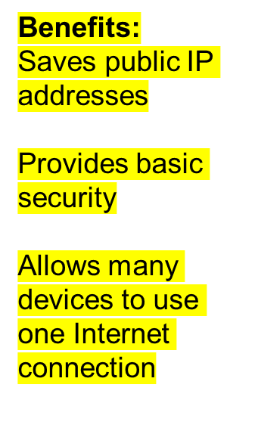
NAT: network address translation
motivation: local network uses just one IP address as far as outside world is concerned:
  range of addresses not needed from ISP: just one IP address for all devices
  can change addresses of devices in local network without notifying outside world
  can change ISP without changing addresses of devices in local network
  devices inside local net not explicitly addressable, visible by outside world (a security plus)
Network Layer
4-<number>

Slide 50
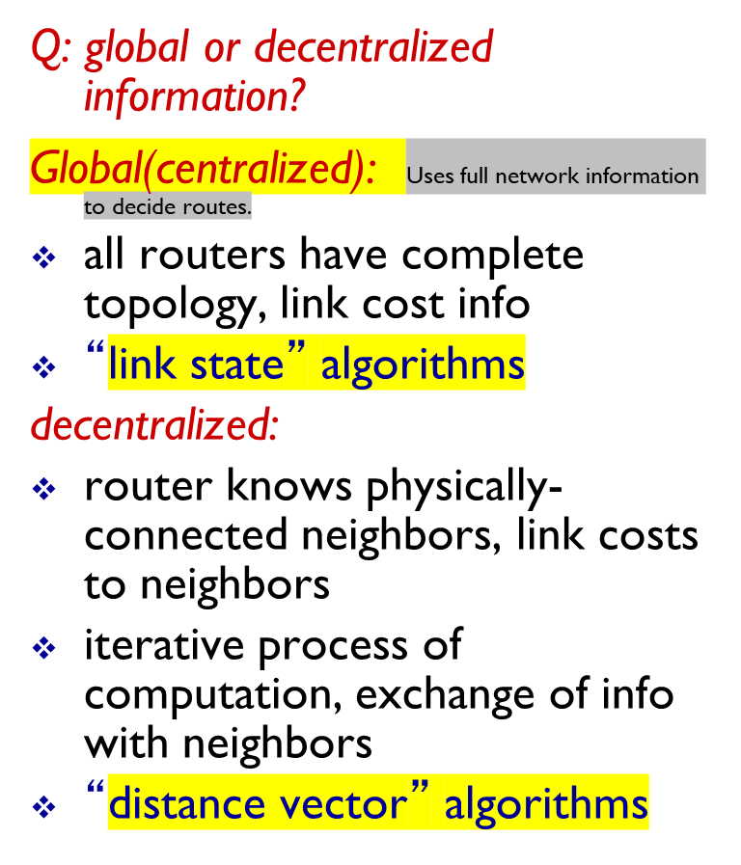
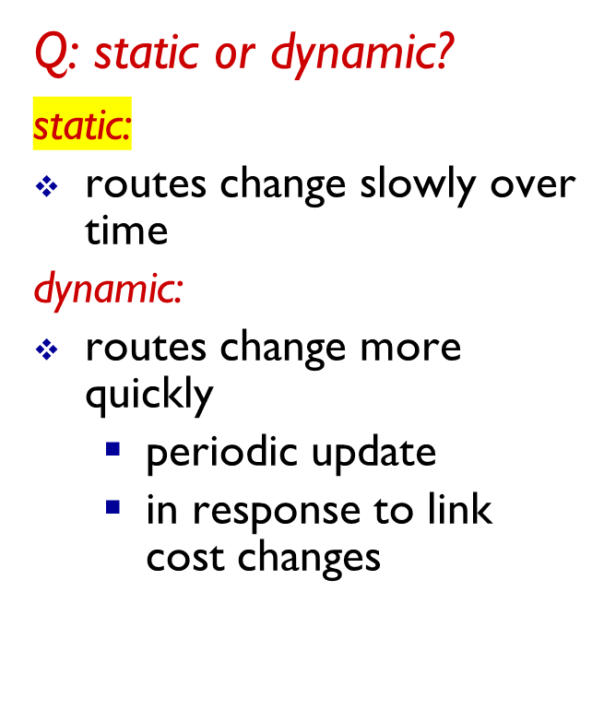
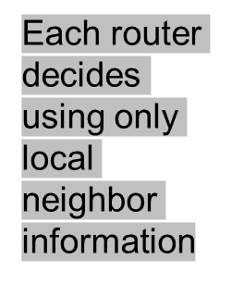
Routing algorithm classification
Network Layer
4-<number>

Slide 51

Figure 2 Autonomous systems

Slide 52



Slide 53

Figure 5 Initialization of tables in distance vector routing

Slide 54

Figure 4 Distance vector routing tables

Slide 55
In distance vector routing, each node shares its routing table with its
immediate neighbors periodically and when there is a change.
22.<number>

Slide 56

Figure 6 Updating in distance vector routing

Slide 57

link state routing

Slide 58

Figure 22.21 Link state knowledge

Slide 59

Figure 22.22 Dijkstra algorithm

Slide 60


Slide 61
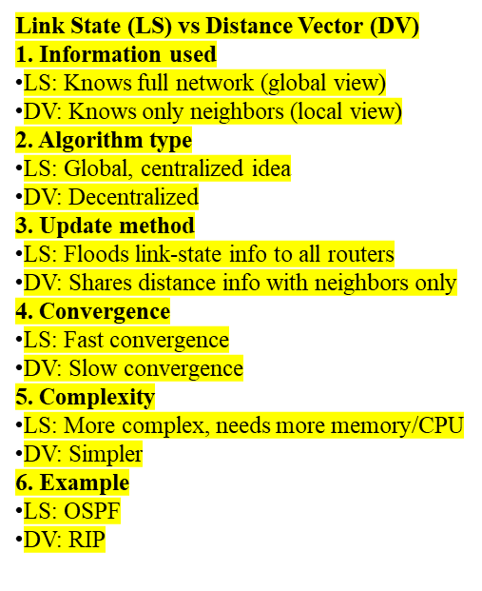
Comparison of LS and DV algorithms
message complexity
LS: with n nodes, E links, O(nE) msgs sent
DV: exchange between neighbors only
  convergence time varies
speed of convergence
LS: O(n²) algorithm requires O(nE) msgs
  may have oscillations
DV: convergence time varies
  may be routing loops
  count-to-infinity problem
robustness: what happens if router malfunctions?
LS:
  node can advertise incorrect link cost
  each node computes only its own table
DV:
  DV node can advertise incorrect path cost
  each node’s table used by others
    error propagate thru network
Network Layer
4-<number>

Slide 62
ICMP: internet control message protocol
used by hosts & routers to communicate network-level information
  error reporting: unreachable host, network, port, protocol
  echo request/reply (used by ping)
network-layer “above” IP:
  ICMP msgs carried in IP datagrams
ICMP message: type, code plus first 8 bytes of IP datagram causing error
Type Code description
0 0 echo reply (ping)
3 0 dest. network unreachable
3 1 dest host unreachable
3 2 dest protocol unreachable
3 3 dest port unreachable
3 6 dest network unknown
3 7 dest host unknown
4 0 source quench (congestion
control - not used)
8 0 echo request (ping)
9 0 route advertisement
10 0 router discovery
11 0 TTL expired
12 0 bad IP header
Network Layer
4-<number>

Slide 63
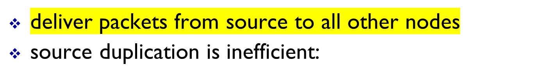
Broadcast routing
duplicate
duplicate
creation/transmission
R1
R1
duplicate
R2
R2
R3
R4
R3
R4
source
duplication
in-network
duplication
source duplication: how does source determine recipient addresses?
Network Layer
4-<number>

Slide 64
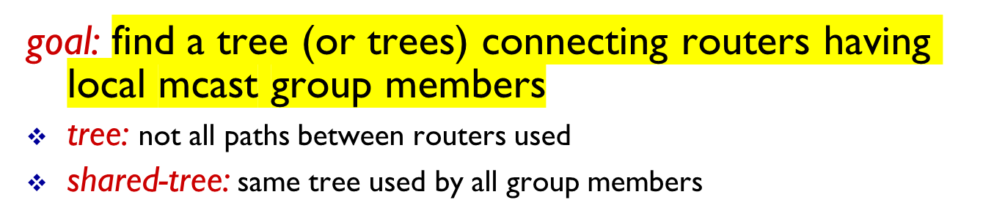



Multicast routing: problem statement
legend
group
member
source-based: different tree from each sender to rcvrs
not group
member
router
with a
group
member
router
without
group
member
shared tree
source-based trees
Network Layer
4-<number>
Notes:
Notes:
3.3 Network Layer: Multicast Routing Algorithms 3-9

